Slide 1
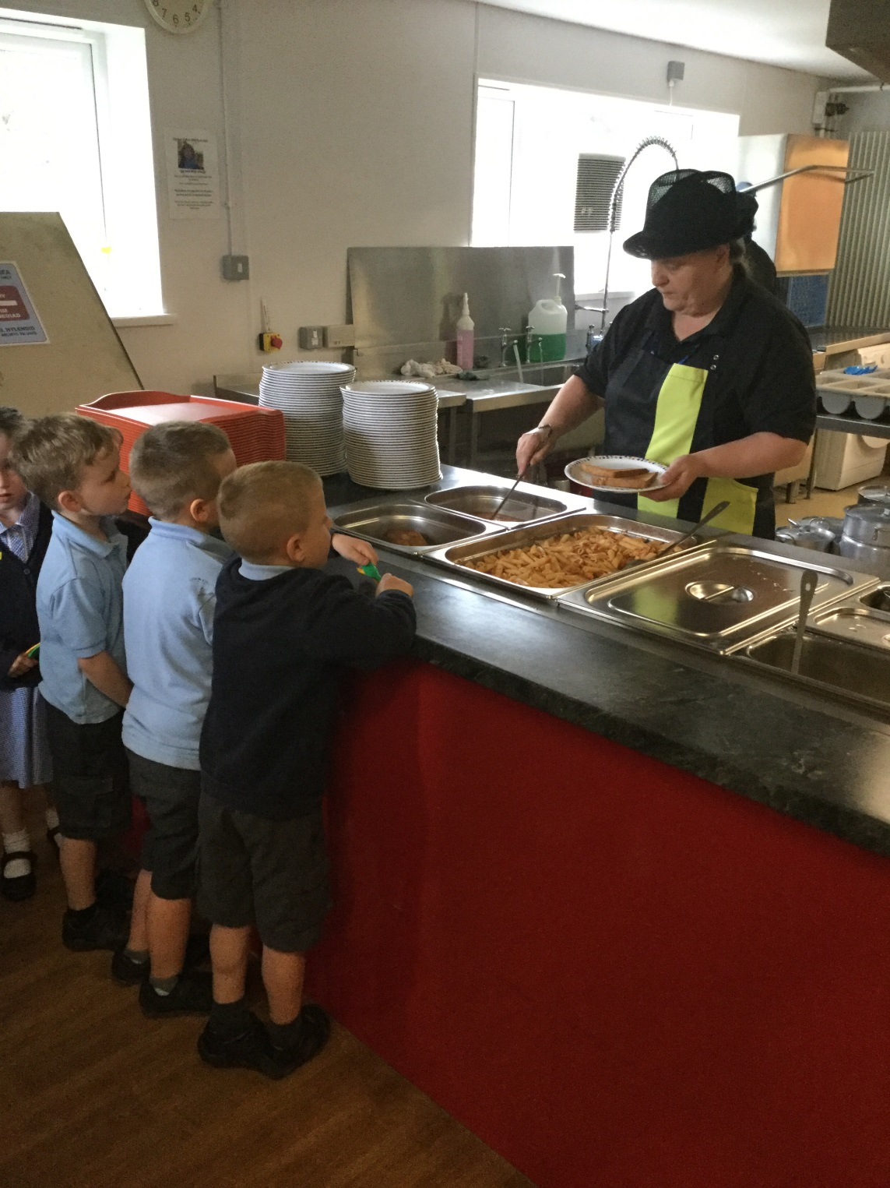
Notes:
Mae dechrau'r ysgol yn llawn profiadau newydd, efallai y bydd rhai plant yn gyfarwydd â bwyta cinio fel rhan o'u profiad cyn-ysgol, ond i eraill bydd hyn yn brofiad dysgu newydd arall.
Mae gennym Glwb Brecwast sy'n agor yn 8.15, manylion yn eich pecyn gwybodaeth.
Hefyd mae gennym troli ffrwythau. Gall plant brynu tocynnau a dewis eu ffrwythau eu hunain yn ystod amser chwarae y bore.
Starting school is full of new experiences, some children may be familiar with eating lunch as part of their preschool experience, but for others it be another new learning experience.
We have a Breakfast Club which opens at 8.15 , details are in your information pack.
We also have a fruit trolley whereby children can buy tokens and choose the their own fruit during morning play.

Slide 2
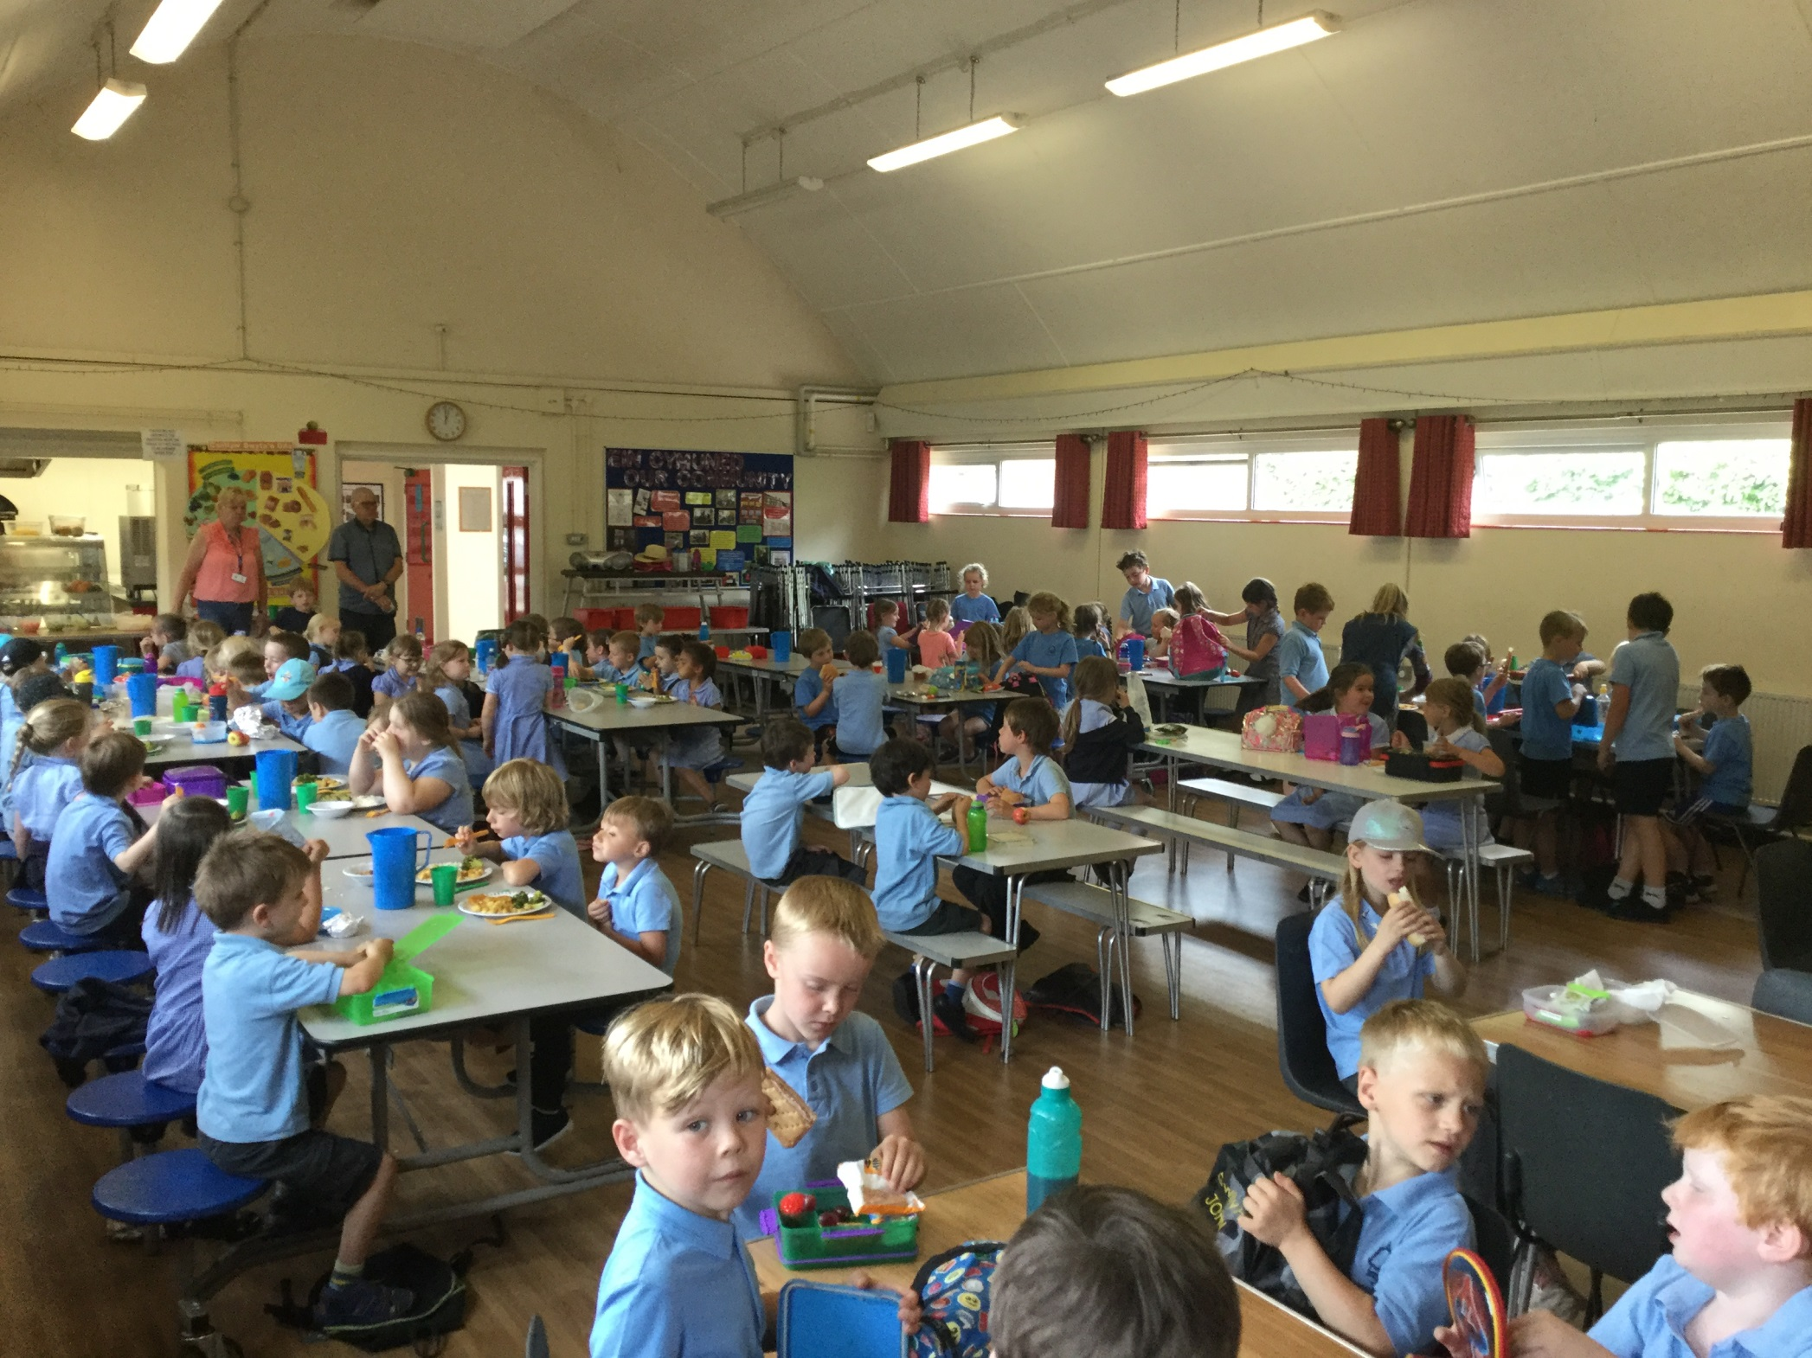
Notes:
Cynrychiolwyr o’r Cyngor Ysgol ydym ni. Hoffwn sôn wrthych am ginio ysgol o a sut ydym yn anog plant i ddod a bocsys cinio iach, fel y gallwch chi ystyried yr opsiynau ar gyfer eich plentyn ym mis Medi.
Mae gennych tamaid o fwyd ar eich byrddau i’w flasu.
Dyma rhai syniadau i’w gynnwys mewn bocs cinio iach!
We are representatives from the School Council. We would like to tell you about school lunches and how we are promoting healthy lunch boxes so that you can consider the options for your child in September.
We have samples of food for you to taste, you may wish to include your healthy lunch boxes!

Slide 3
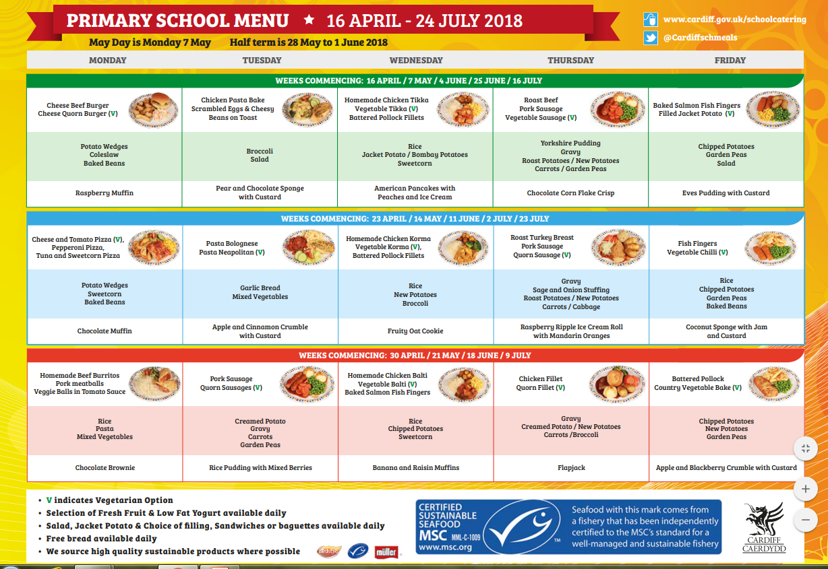
Notes:
Mae cinio wedi'u coginio'n iach ar gael i'r holl blant. Y gost bresennol yw £ 2.50 yr dydd. Mae bwydlen wythnosol ar wefan ysgolion cyngor Caerdydd.
Healthy cooked lunches are available to all children. The current cost is £2.50 a day. You’ll find the weekly menu posted on the Cardiff council schools website.

Slide 4
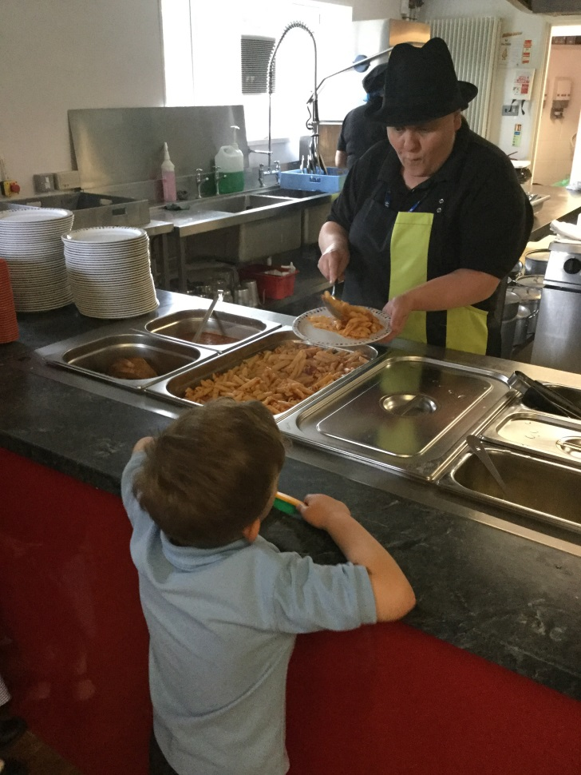
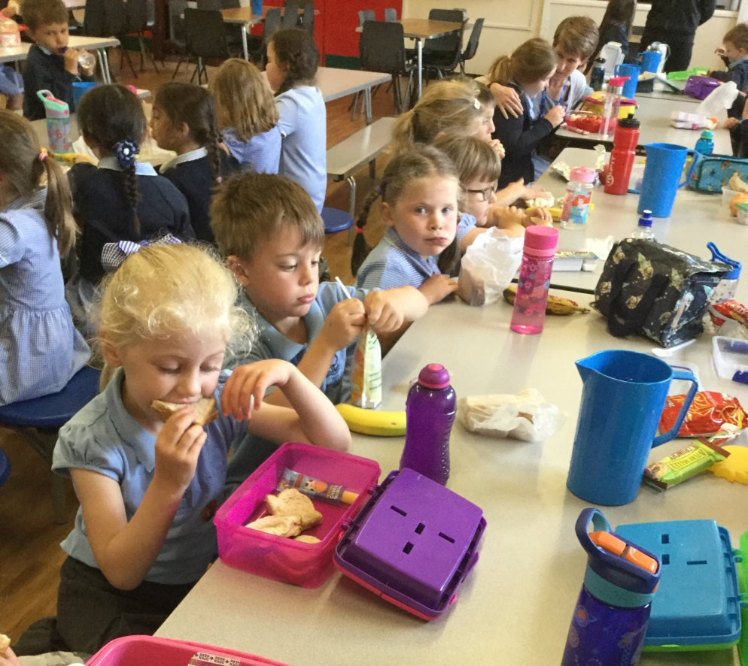
Notes:
Mae amser cinio yn amser cymdeithasol a pleserus.
Gall plant eistedd i fwyta gyda'u ffrindiau.
Er mwyn sicrhau bod hwn yn brofiad pleserus, gallwch chi helpu eich plentyn trwy sicrhau eu bod yn barod ar gyfer y cam nesaf hwn o dyfu annibyniaeth.
Er enghraifft
A ydynt yn gallu ............... .. Agor eu bocs cinio?
Tynu’r clawr I ffwrdd o’r iogwrt?
Defnyddio gyllell a fforc yn y dwylo cywir ?
Lunchtime is a social and enjoyable time. Children can sit to eat with their friends.
To ensure this is a enjoyable experience you can help your child by making sure they are prepared for this next stage of growing independence.
For example
Are they able to…………….. Open their lunch box?
Take the lid off a yogurt?
Use a knife and fork in the correct hands ?

Slide 5
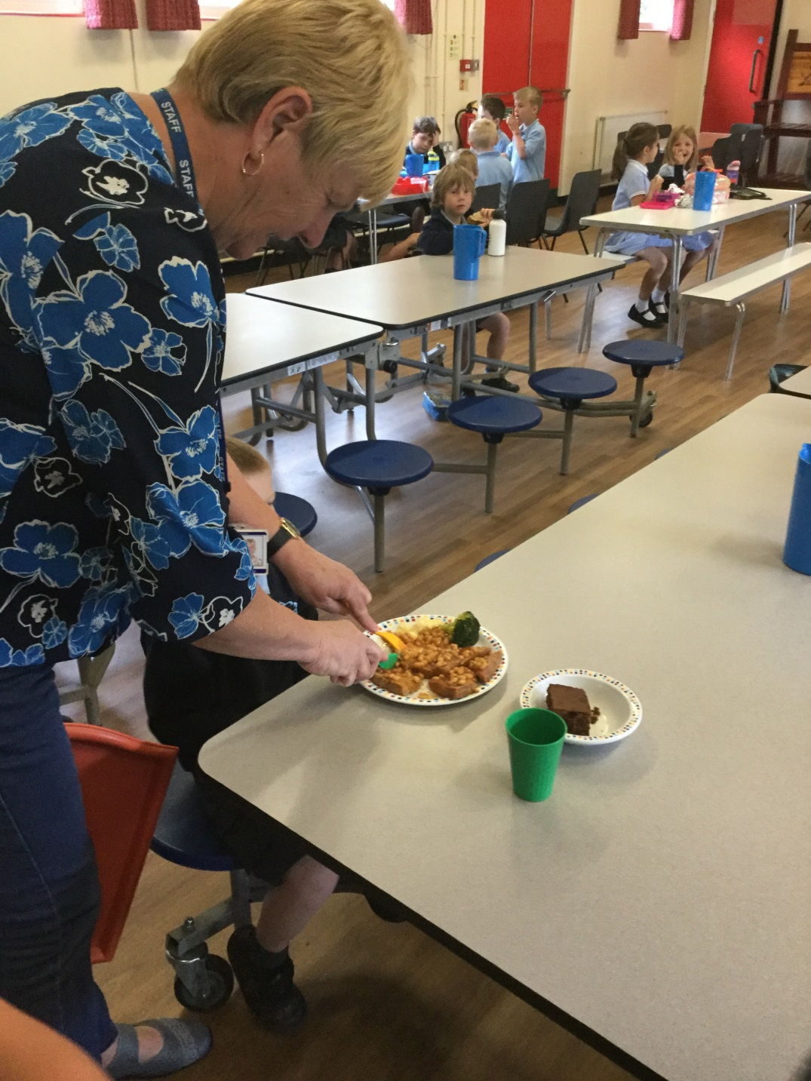
Notes:
Peidiwch becso, mae staff ar gael i helpu.
Don’t worry, there are staff to help.

Slide 6
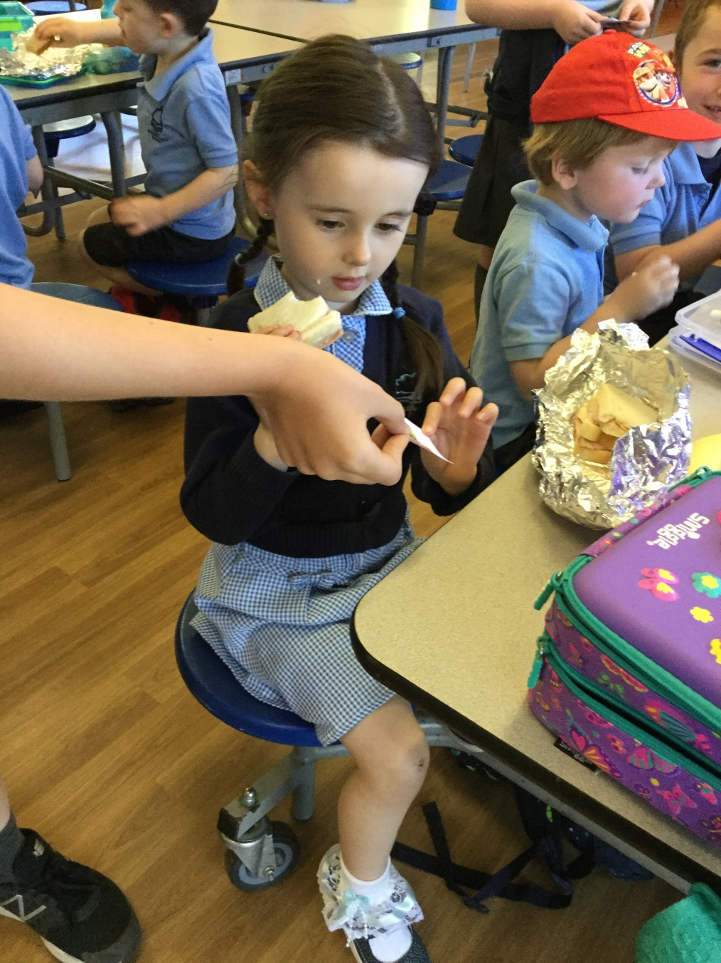
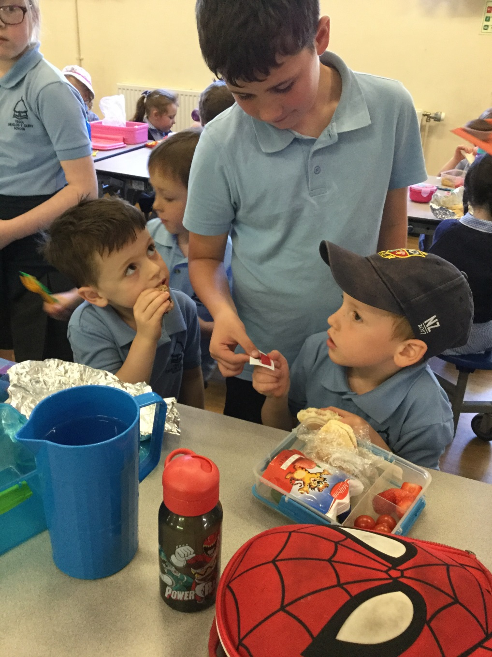
Notes:
Mae gennym gystadleuaeth fisol yn yr ysgol lle mae’r dosbarth buddugol wobr yn ennill gwobr ac amser chwarae hir.
We have a monthly competition in school. The winning class is awarded with a prize and extended playtime.

Slide 7
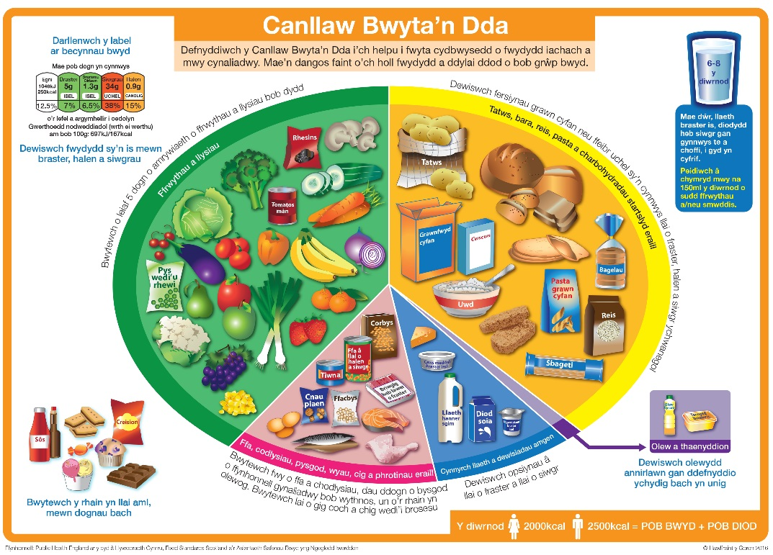
Notes:
Rydym wedi defnyddio’r Canllaw Bwyta'n Dda sy'n ein helpu sut i gael deiet cytbwys iach.

Slide 8
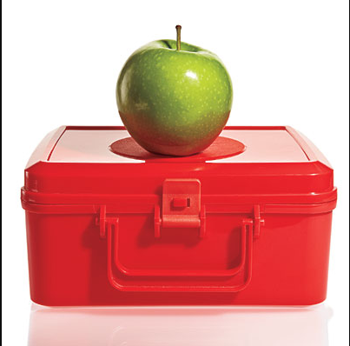
Enillir tocyn am focs cinio iach.
I dderbyn tocyn
Dylai eich bocs cinio gynnwys o leiaf 3 o'r canlynol:
Ffrwythau a/neu lysiau.
Bara, reis neu basta.
Cynnyrch llaeth fel iogwrt a chaws.
Ffa, corbys, pysgod, wyau, cig.
Notes:
Enillir tocyn am focs cinio iach.
I dderbyn tocyn
Dylai eich bocs cinio gynnwys o leiaf 3 o'r canlynol:
Ffrwythau a/neu lysiau.
Bara, reis neu basta.
Cynnyrch llaeth fel iogwrt a chaws.
Ffa, corbys, pysgod, wyau, cig.

Slide 9
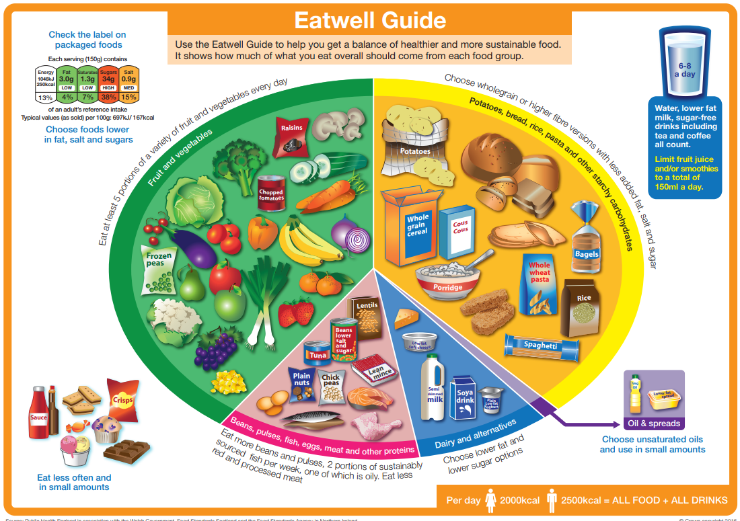
Notes:
We have used the Eatwell Guide which helps us to get a healthy balanced diet.

Slide 10
A token is awarded for a healthy lunch box.
To receive a token
Your lunchbox should include at least 3 of the following:
Fruit and / or vegetables.
Bread, rice or pasta.
Dairy products such as milk, yogurt or cheese.
Eat some beans, pulses, fish, eggs, meat.
Notes:
A token is awarded for a healthy lunch box.
To receive a token
Your lunchbox should include at least 3 of the following:
Fruit and / or vegetables.
Bread, rice or pasta.
Dairy products such as milk, yogurt or cheese.
Eat some beans, pulses, fish, eggs, meat.

Slide 11
Notes:
Nid yw’r plant yn cael eu chosbi am beidio cael bocs cinio iach. Os mae bwydydd fel hyn, anogir i’r plant i gael y rhain yn llai aml ac mewn symiau bach.
Children are not penalised for not having a healthy lunch box. If there are food like these in a child’s lunch box they are encouraged to have these less often and in small amounts.

Slide 12
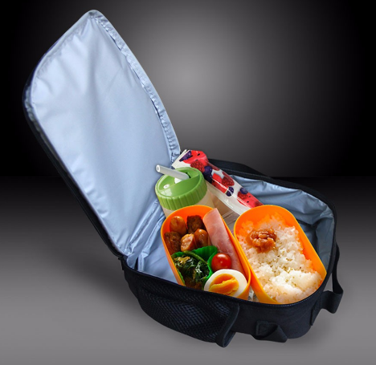
Cadwch yn oer ac yn lân!
1. Bocs cinio y gellir ei ail-ddefnyddio.
2. Bag wedi’i insiwleiddio.
3. Pecyn rhew neu photel o ddŵr wedi'i rewi fel pecyn iâ.
4. Storiwch y cinio pecyn yn yr oergell dros nos.
Notes:
Cadwch eich bocs cinio yn lân ac yn oer.
Dewiswch focs cinio y gellir ei ail-ddefnyddio, mae hyn yn llawer gwell i'r amgylchedd
Defnyddiwch fag wedi'i inswleiddio i gadw bwyd yn oer.
Defnyddiwch becyn rhew neu photel o ddŵr wedi'i rewi fel pecyn iâ.
Storiwch y cinio pecyn yn yr oergell dros nos.

Slide 13
Keep it cool and clean!
A reusable lunch box is much better for the environment
Use an insulated bag.
A frozen ice pack is a must or use a frozen bottle of water as an ice pack.
Store the packed lunch in the fridge overnight.
6 Tips for Keeping Lunch Cool
Notes:
Keep your lunch box clean and cool
Choose a reusable lunch box is much better for the environment.
2. Use an insulated bag to keep food cool.
3. A frozen ice pack is a must to keep food at a safe temperatue,
or use a frozen bottle of water as an ice pack.
4. Store the packed lunch in the fridge overnight.

Slide 14
Notes:
Mae llawer o syniadau o fwydydd i gynnwys yn eich bocsys bwyd ar gael ar y wê.
Yr ydym wedi nodi’r cyfeiriadau yn y daflen.
There a lots of ideas for healthy lunch boxes on the internet. We have listed some useful addresses in your leaflet.

Slide 15
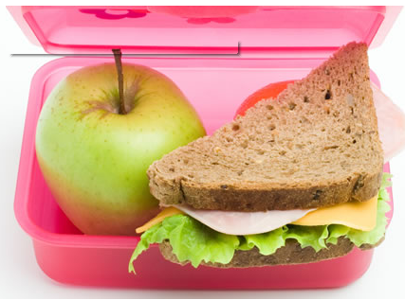
Notes:
Diolch am wrando ac am eich cefnogaeth.
Gobeithio eich bod wedi mwynhau blasu’r bwyd!
Thank you for listening and your support.
We hope that you have enjoyed the tasters!

